Slide 1
Game Theoretical Approaches in Multi-Agent Reinforcement Learning
Lim Jin Xing
Sai Ganesh Nagarajan

Slide 2
Contents
Recap on the PSRO Algorithm
Open-ended Learning in Symmetric Zero-sum Games
Zero-Sum Games (Transitive VS Cyclic)
Training Objectives
Self-play VS PSROrN
Experiments (Self-play VS PSROrN)
Disc Game
Lotto
Future Works

Slide 3
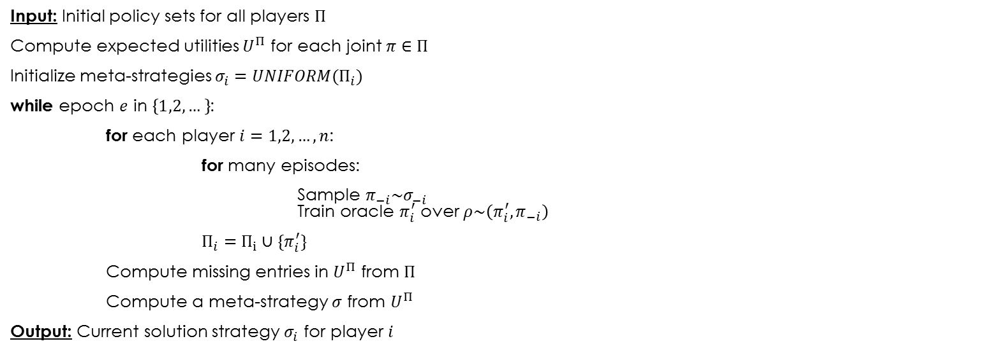
PSRO Algorithm [Lanctot, et al ‘17]
Input: Initial policy sets for all players $Π$
Compute expected utilities $U^{Π}$ for each joint $π∈Π$
Initialize meta-strategies $σ_{i}=UNIFORM(Π_{i})$
while epoch $e$ in $\left\{1,2,…\right\}$:
for each player $i=1,2,…,n$:
for many episodes:
Sample $π_{−i}\sim σ_{−i}$ Train oracle $π_{i}^{′}$ over $ρ\sim \left(π_{i}^{′},π_{−i}\right)$
$Π_{i}=Π_{i}∪\{π_{i}^{′}\}$
Compute missing entries in $U^{Π}$ from $Π$
Compute a meta-strategy $σ$ from $U^{Π}$
Output: Current solution strategy $σ_{i}$ for player $i$
RL Process (Reactor [Gruslys, et al ‘17])
Meta-Strategy Solver (empirical game-theoretic analysis):
Regret Matching
Hedge
Projected Replicator Dynamics (PRD) *NEW*
Marc Lanctot, Vinicius Zambaldi, Audrunas Gruslys, Angeliki Lazaridou, Karl Tuyls, Julien Perolat, David Silver, and Thore Graepel. 2017. A Unified Game-Theoretic Approach to Multiagent Reinforcement Learning. In Advances in Neural Information Processing Systems 30, I. Guyon, U. V. Luxburg, S. Bengio, H. Wallach, R. Fergus, S. Vishwanathan, and R. Garnett (Eds.). 4190–4203.
Audrunas Gruslys, Mohammad Gheshlaghi Azar, Marc G. Bellemare, and Remi Munos. The Reactor: A sample-efficient actor-critic architecture. CoRR, abs/1704.04651, 2017.

Slide 4
Consider Zero-Sum games…
Key Question : How do we train agents in games that look like rock-paper-scissors?
Balduzzi, D., Garnelo, M., Bachrach, Y., Czarnecki, W., Pérolat, J., Jaderberg, M., & Graepel, T. (2019). Open-ended Learning in Symmetric Zero-sum Games. CoRR, abs/1901.08106.

Slide 5
Zero-sum Games = Transitive + Cyclic Games
Theorem: Any zero-sum game can be decomposed into two components:
TRANSITIVE + CYCLIC
TRANSITIVE : A beats B and B beats C => A beats C (there will be a global winner) – eg. Chess, Go
CYCLIC: If A beats B, there exists a C such that B beats C but C beats A (every strategy will have a counter-strategy) – eg. RPS, Dota, Starcraft

Slide 6
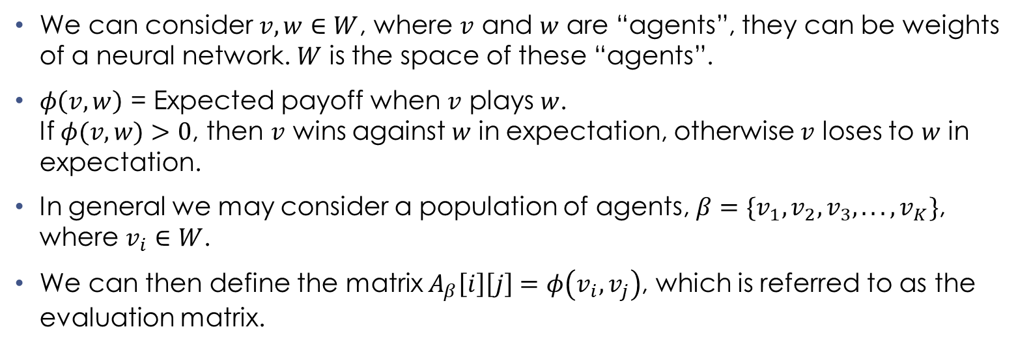
Functional Form Games and Empirical Games
We can consider $v,w∈W$, where $v$ and $w$ are “agents”, they can be weights of a neural network. $W$ is the space of these “agents”.
$φ\left(v,w\right)$ = Expected payoff when $v$ plays $w$. If $φ(v,w)>0$, then $v$ wins against $w$ in expectation, otherwise $v$ loses to $w$ in expectation.
In general we may consider a population of agents, $β=\{v_{1},v_{2},v_{3},...,v_{K}\}$, where $v_{i}∈W$.
We can then define the matrix $A_{β}\left[i\right]\left[j\right]=φ\left(v_{i},v_{j}\right)$, which is referred to as the evaluation matrix.

Slide 7
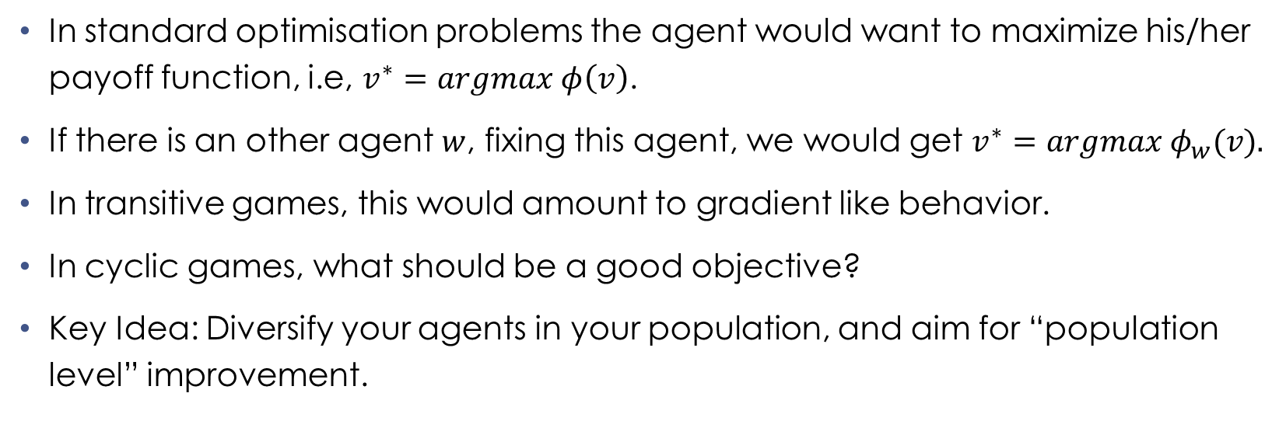
Training Objectives
In standard optimisation problems the agent would want to maximize his/her payoff function, i.e, $v^{∗}=argmax φ\left(v\right)$.
If there is an other agent $w$, fixing this agent, we would get $v^{∗}=argmax φ_{w}(v).$
In transitive games, this would amount to gradient like behavior.
In cyclic games, what should be a good objective?
Key Idea: Diversify your agents in your population, and aim for “population level” improvement.

Slide 8
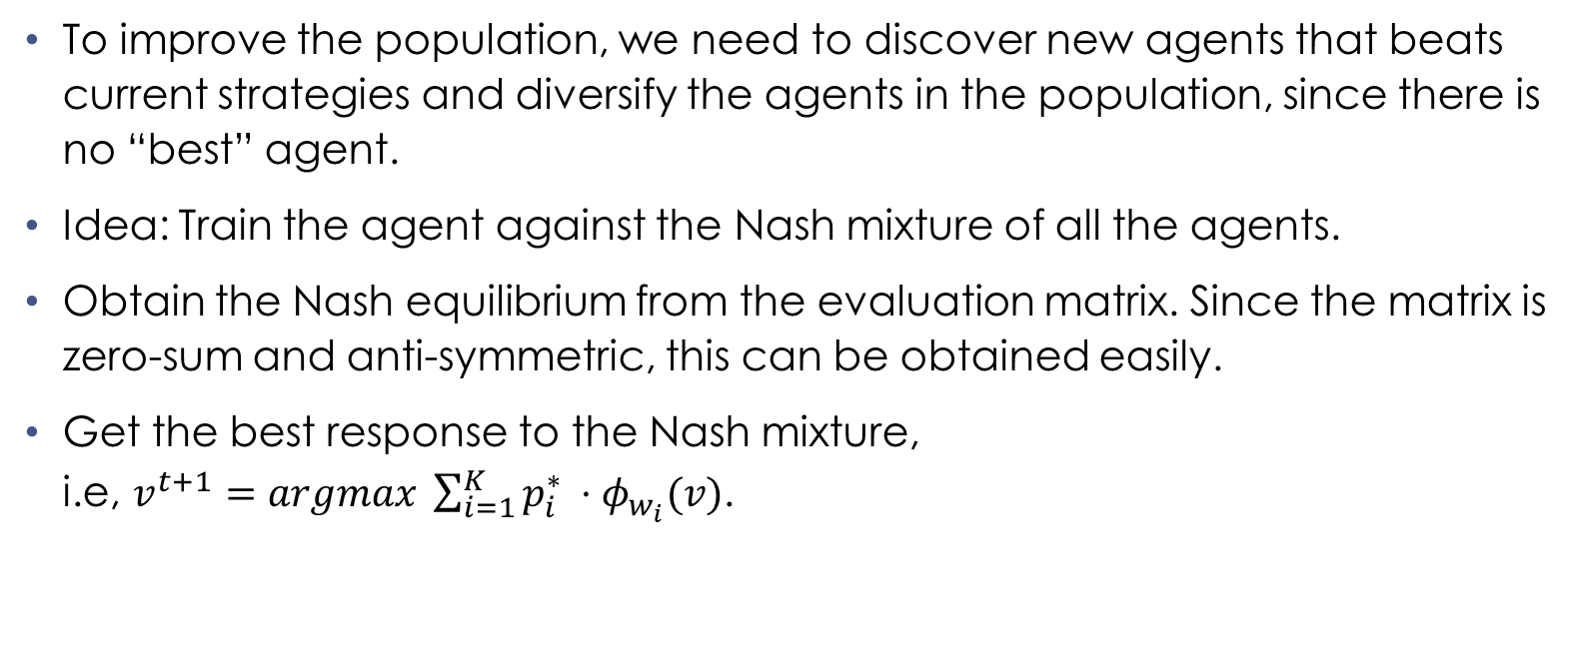
Train against Nash
To improve the population, we need to discover new agents that beats current strategies and diversify the agents in the population, since there is no “best” agent.
Idea: Train the agent against the Nash mixture of all the agents.
Obtain the Nash equilibrium from the evaluation matrix. Since the matrix is zero-sum and anti-symmetric, this can be obtained easily.
Get the best response to the Nash mixture, i.e, $v^{t+1}=argmax \sum_{i=1}^{K}{p_{i}^{∗} ⋅φ_{w_{i}}(v)}$.

Slide 9
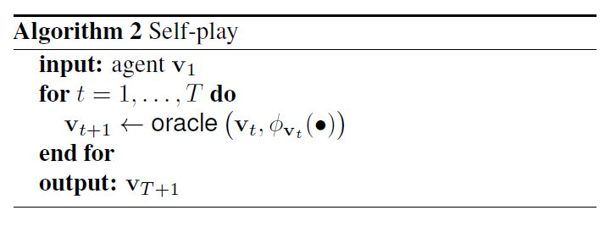
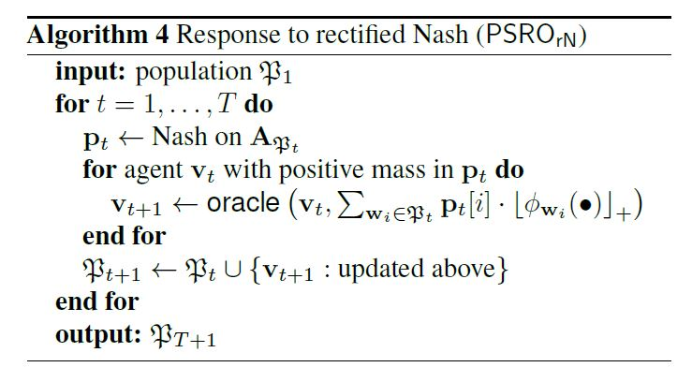
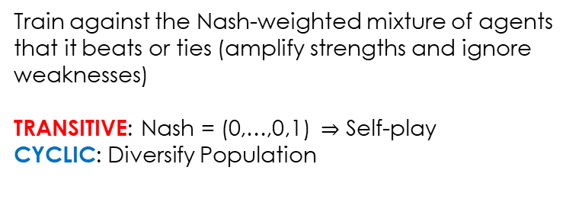
Self-play VS PSROrN
Train against the last agent
TRANSITIVE: Good (eg. Chess, Go, etc)
CYCLIC: Bad (No best agent)
Train against the Nash-weighted mixture of agents that it beats or ties (amplify strengths and ignore weaknesses)
TRANSITIVE: Nash = (0,…,0,1) $⇒$ Self-play
CYCLIC: Diversify Population

Slide 10
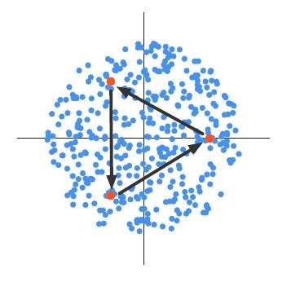

Disc Game
Let $v,w∈R^{2}$:
Payoff function: $φ\left(v,w\right)=v_{1}w_{2}−v_{2}w_{1}$
This game is CYCLIC
RPS embeds in disc game via (for $ε∈[0,1]$)
$r_{ε}=\frac{\sqrt{3}ε}{2}\left(\cos{0},\sin{0}\right)$
$p_{ε}=\frac{\sqrt{3}ε}{2}(\cos{\frac{2π}{3}},\sin{\frac{2π}{3}})$
$s_{ε}=\frac{\sqrt{3}ε}{2}(\cos{\frac{4π}{3}},\sin{\frac{4π}{3}})$
$A=\left[\begin{matrix}0 & ε^{2} & −ε^{2} \\ {−ε}^{2} & 0 & ε^{2} \\ ε^{2} & −ε^{2} & 0\end{matrix}\right]$

Slide 11
Disc Game: PSROrN VS Self-play
PSROrN
Self-play

Slide 12
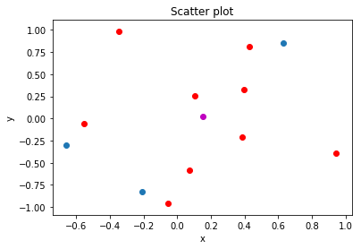
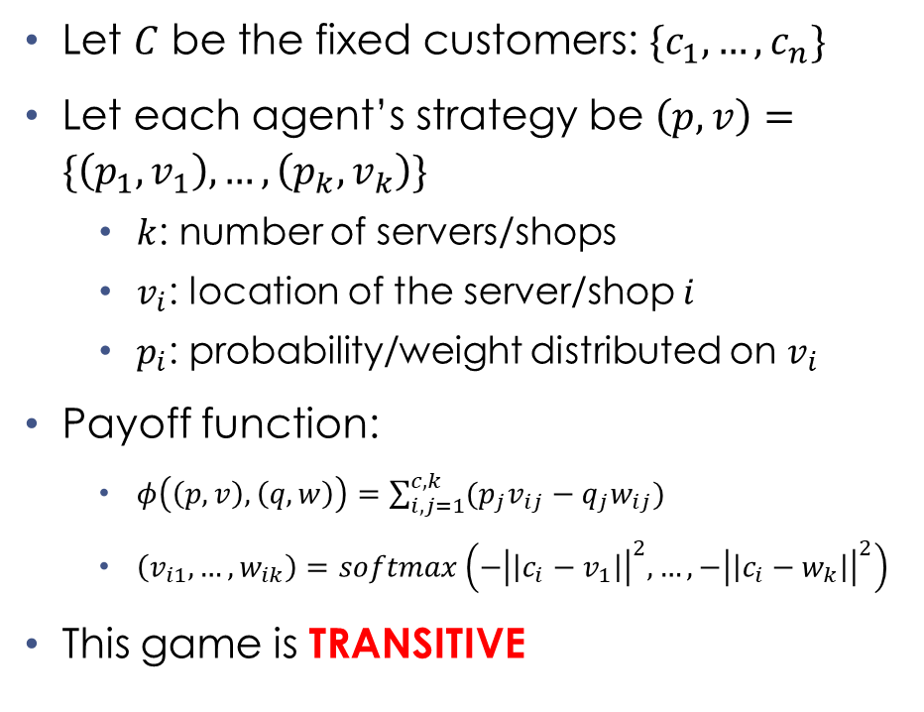
Lotto
Let $C$ be the fixed customers: $\{c_{1},…,c_{n}\}$
Let each agent’s strategy be $\left(p,v\right)=\{\left(p_{1},v_{1}\right),…,\left(p_{k},v_{k}\right)\}$
$k$: number of servers/shops
$v_{i}$: location of the server/shop $i$
$p_{i}$: probability/weight distributed on $v_{i}$
Payoff function:
$φ\left(\left(p,v\right),\left(q,w\right)\right)=\sum_{i,j=1}^{c,k}{(p_{j}v_{ij}−q_{j}w_{ij})}$
$\left(v_{i1},…,w_{ik}\right)=softmax\left(−{\left|\left|c_{i}−v_{1}\right|\right|}^{2},…,−{\left|\left|c_{i}−w_{k}\right|\right|}^{2}\right)$
This game is TRANSITIVE

Slide 13
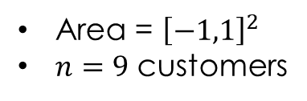
Lotto (Self-play VS PSROrN)
Area = ${\left[−1,1\right]}^{2}$
$n=9$ customers
$k=3$ | $k=9$ | $k=15$

Slide 14
Future Works
Self-play in multi-player settings.
Need to consider settings where results on game dynamics and equilibria are well understood.
Network zero-sum games are somewhat a good generalisation of the two-player settings which keeps things tractable and the game dynamics (at least for small number of players are well understood).
The “additive” nature of the PSROrN may allow for this type of extension.

Slide 15
References
K. Tuyls, J. Perolat, M. Lanctot, J. Z. Leibo, and T. Graepel, “A Generalised Method for Empirical Game Theoretic Analysis ,” in AAMAS, 2018.
K. Tuyls and A. Now´e. Evolutionary game theory and multi-agent reinforcement learning. The Knowledge Engineering Review, 20(1):63–90, March 2006.
Balduzzi, David, et al. "Open-ended Learning in Symmetric Zero-sum Games." arXiv preprint arXiv:1901.08106 (2019).
Cai, Yang, et al. "Zero-sum polymatrix games: A generalization of minmax." Mathematics of Operations Research 41.2 (2016): 648-655.
Piliouras, Georgios, and Jeff S. Shamma. "Optimization despite chaos: Convex relaxations to complex limit sets via Poincaré recurrence." Proceedings of the twenty-fifth annual ACM-SIAM symposium on Discrete algorithms. Society for Industrial and Applied Mathematics, 2014.

